Slide 1

Car Price Prediction Project

Slide 2

Covid 19 has caused an uproar in the automotive market and the prices of used cars are all over the place.
To better understand this, the client needs a new machine learning model to better mark the prices on the used cars which are market competitive and can help him gain value on cars.

Slide 3

Objective of the project
Mine current data from online car selling websites
Create a predictive model which can predict the price of te car on the basis various independent variables like, year and fuel type.
Understand the impact of such variables on the price of the car and how are they related to each other.

Slide 4


Data Source
Data is mined from Ola cars and Cardekho from 5 different cities in India.
Ola cars | 3169 samples
CarDekho | 2000 samples

Slide 5
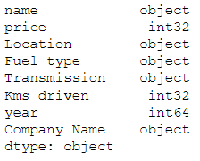
Data mined:
Number of independent variables mined from the websites:

Slide 6
Motivation and Data Science
The objective behind this project was to provide the client with an overview of how used car prices can be marked efficiently with a statistical model.
Cars have certainly become a necessary part of our daily lives. They represent social status, general and an urgent utility.
They have integrated people living far off much better than any other means of transportation. The degree of freedom and privacy this mode provides, no other means of travel can even compare.
With the growing need of cars, old cars have become a burden on the environment if every time they need to be scrapped.

Slide 7

Testing of Algorithms
1. Lasso Regression
2. Decision Tree Regressor
3. Random Forest Regressor
4. XGB regressor

Slide 8
Models
R2 Score:
Cross validation Score:
Model | Score
Decision Tree Regressor | 66.91602137576673
Random Forest Regressor | 66.91602137576673
Lasso Regression | 36.42172238391035
XGB Regressor | 86.68541041192348
Model | Score
Decision Tree Regressor | 57.107691100804125
Random Forest Regressor | 71.94726181955497
Lasso Regression | 30.41666056374264
XGB Regressor | 83.45996117921885

Slide 9
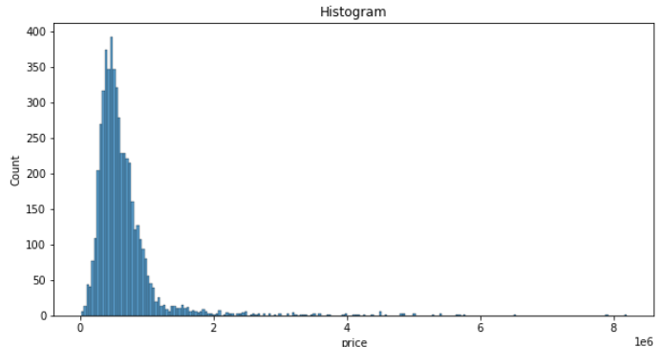
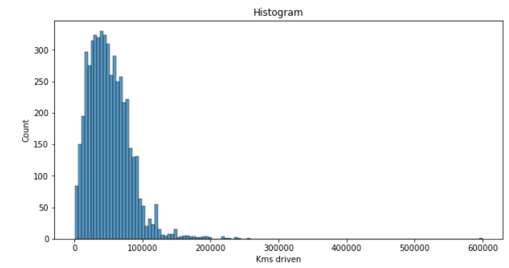
Visualizations
Observations:
- Majority of the price is centred around 500,000
- Maximum distance driven by cars hovers around 45000 km

Slide 10
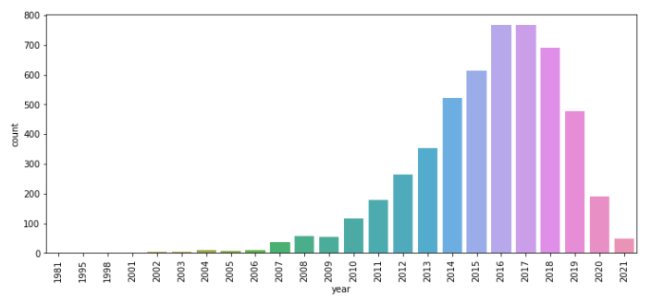
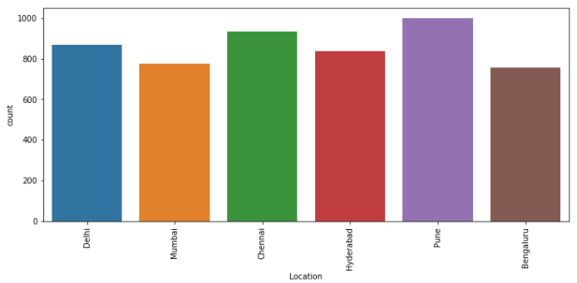

Slide 11
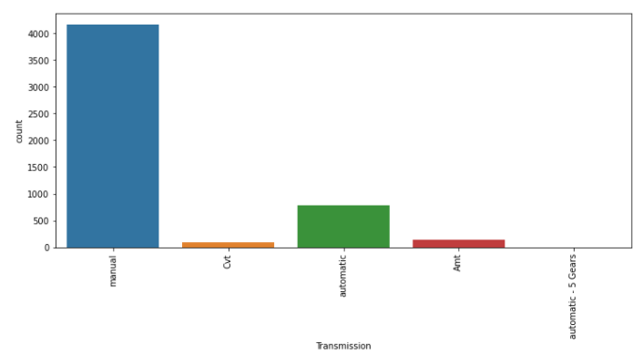
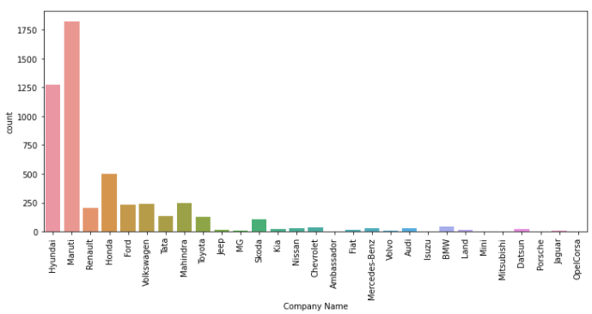
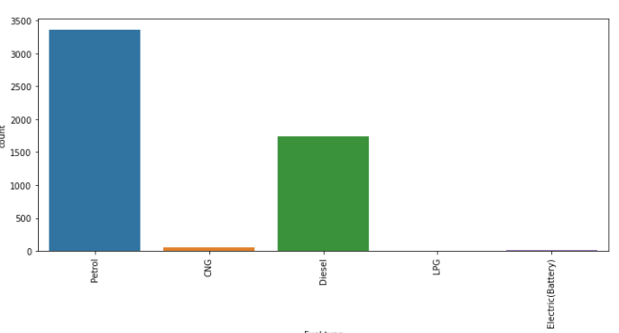
- Out of the 5k cars, Maruti Suzuki and Hyundai are the most used car companies which has been put up for sale, indicating high penetration in the Indian market compared to its rivals.
- Manual Transmission is abundant as the cars tend to be cheaper which makes sense for the Indian market
- We have almost equal number of cars available from all the 5 major cities.
- Petrol cars have the highest quantity to be listed for sale, as petrol have an extra benefit compared to Diesel - it can be converted to run on CNG, which is almost 50% cheaper than petrol and diesel and cleaner for the environment.
- Most cars are relatively new with majority belonging to 2014 to 2019

Slide 12
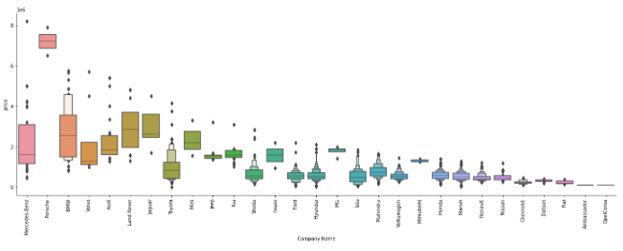
Observation:
- We can see majority of the companies have outlier prices.
-Luxurious brands will logically be expensive than commercial car brands, like Porsche is the one of the most expensive car companies globally.

Slide 13
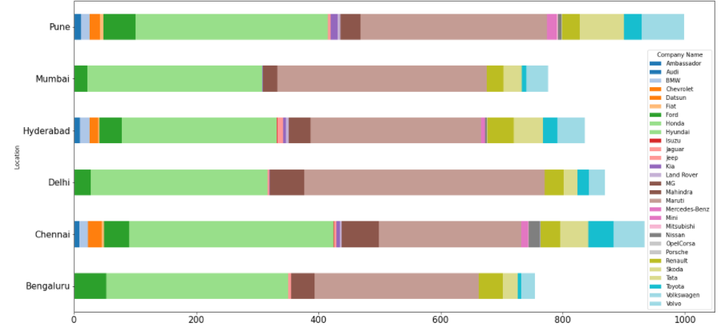
Observation:
- Chennai has more Hyundai’s listed than Maruti's indicating the famous car company in the city.
- Delhi has the largest number of Maruti's listed
- Chennai also tops the list in terms of Toyota’s listed.

Slide 14
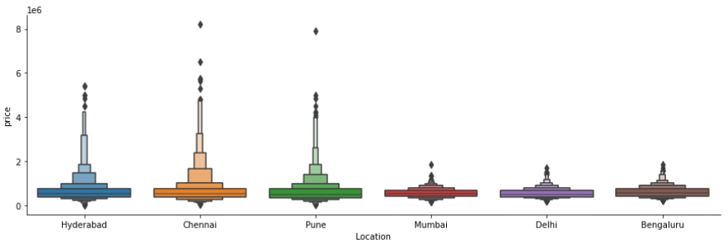
Observation:
-Mumbai, Delhi and Bengaluru have only inexpensive cars listed whereas the other 3 definitely have a lot of expensive cars listed as well.
-All the cities have almost equal average listed price.

Slide 15
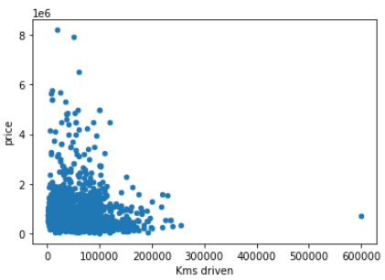
Observation:
- Lesser driven vehicles will obviously cost more which is what the graph depicts.

Slide 16
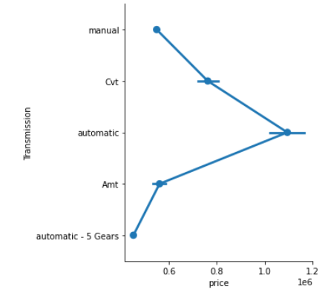
Observations:
- Automatic cars are the most expensive with CVT coming in at second.

Slide 17
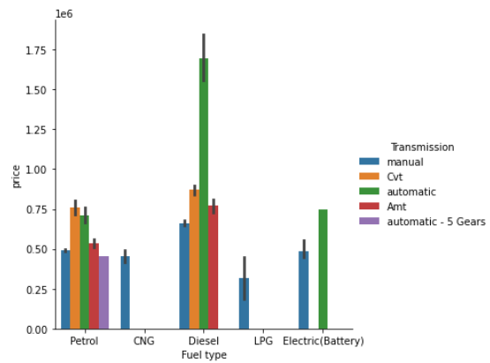
Observations: - manual cars with LPG are the cheapest combo available - automatic and diesel is the highest priced option listed - electric cars have only manual or automatic transmission - CVT transmission (manual with no clutch pedal) is the second highest in terms of price in diesel variant, but cars having petrol as their fuel type, it's the most expensive type of transmission.

Slide 18


